Slide 1
Inferential Statistics

Slide 2
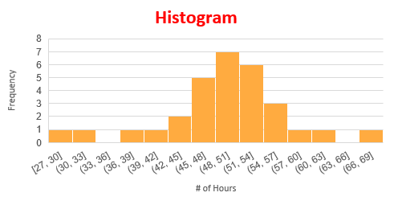
Descriptive Statistics – Summarizing Data
Sample # | Hrs | Sample # | Hrs | Sample # | Hrs
1 | 55 | 11 | 45 | 21 | 39
2 | 46 | 12 | 50 | 22 | 52
3 | 52 | 13 | 68 | 23 | 33
4 | 51 | 14 | 54 | 24 | 51
5 | 48 | 15 | 46 | 25 | 54
6 | 50 | 16 | 48 | 26 | 59
7 | 27 | 17 | 47 | 27 | 42
8 | 53 | 18 | 44 | 28 | 49
9 | 57 | 19 | 49 | 29 | 56
10 | 50 | 20 | 62 | 30 | 53
Mean: 49.67 Hrs
Median: 50 Hrs
Mode: 50 Hrs
Range: 41 Hrs (Max:68Hrs, Min: 27Hrs)
IQR: 8 Hrs
Std.Dev.: 7.81 Hrs
Dispersion: 15.62%

Slide 3
Revisiting Distributions -Concept of Sampling Distribution
A new mobile model claims a battery life of 48 hours – How do we test it?
It might be difficult to check every piece (N) individuals of the population, and therefore we will take a sample of size “n” from the N pieces to do the test.
We find out the battery life of “n” batteries, and take an average and see how close the average is to “48 Hours”

Slide 4
Revisiting Distributions Concept of Sampling Distribution
What we are now interested is not in individual values of the test data (Battery Life in Hours), but the average of all test data
We are therefore now interested in knowing how will the averages be distributed if we take all possible samples of size “n” from the population of N Batteries
– It is called the “Sampling Distribution of Mean”

Slide 5
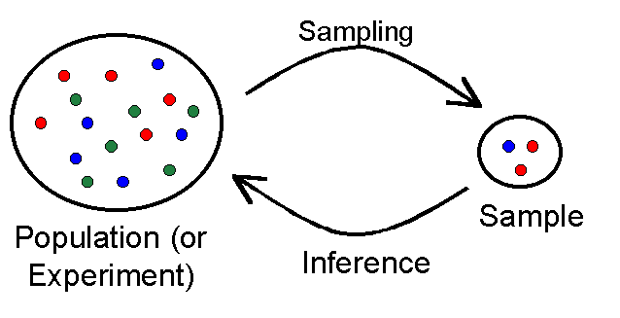
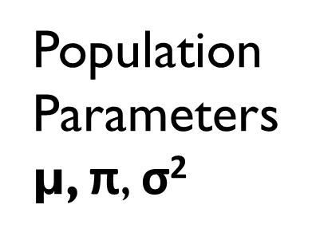
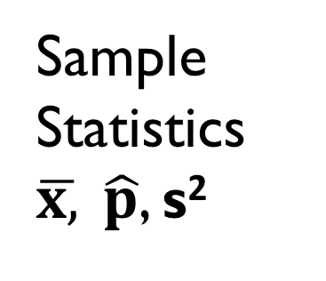
Distributions -Population and Samples
Population Parameters
µ, $\text{π}$, σ²
Sample Statistics
$\overline{x,} \hat{p}$, s²
Method of Sampling, and Size of Sample are important to inference
The sampling distribution enables us to understand the relationship between the test statistics, and the population parameter values

Slide 6
Example of Sampling Distribution (Mean)
Population (N=5) 1 3 5 7 9 : Mean µ = 5 : Variance σ² = 8
Let’s say, to Estimate the population mean we take a sample of 2 (n=2)
Possible samples of 2 are
Mean (Sample Mean ) | 5
Variance (Sample Mean) | 3
Samples of 2 | 1 | 3
 | 1 | 5
 | 1 | 7
 | 1 | 9
 | 3 | 5
 | 3 | 7
 | 3 | 9
 | 5 | 7
 | 5 | 9
 | 7 | 9
Sample Mean x̅
2
3
4
5
4
5
6
6
7
8
SAMPLE
SPACE
There is a 20% chance of getting a mean of < 4, or > 6, when the true mean is 5
x̅ | 2 | 3 | 4 | 5 | 6 | 7 | 8
% Probability | 10% | 10% | 20% | 20% | 20% | 10% | 10%
Some
Events
When the “True” Population Mean is 5, and if you take a sample of two to estimate it, you can get any value between 2 and 8 – It is a function of sample size, and the variability that exists in the population
 | Average
5

Slide 7
Example of Sampling Distribution (Mean)
Population (N=5) 1 3 5 7 9 : Mean µ = 5 : Variance σ² = 8
Let’s say, to Estimate we take a sample of 3 (n=3)
Possible samples of 3 are
Mean (Sample Mean ) | 5
Variance (Sample Mean) | 1.33
Samples of 3
Sample Mean x̅
3.00
3.67
4.33
4.33
5.00
5.67
5.00
5.67
6.33
7.00
1 | 3 | 5
1 | 3 | 7
1 | 3 | 9
1 | 5 | 7
1 | 5 | 9
1 | 7 | 9
3 | 5 | 7
3 | 5 | 9
3 | 7 | 9
5 | 7 | 9
x̅ | 3 | 3.67 | 4.33 | 5 | 5.67 | 6.33 | 7
% Probability | 10% | 10% | 20% | 20% | 20% | 10% | 10%
As the sample size increases, the range of possible estimated mean value narrows down

Slide 8




Example of Sampling Distribution (Mean)
Population (N=5) 1 3 5 7 9 : Mean µ = 5 : Variance σ² = 8
For n = 2
Mean (Sample Mean ) | 5
Variance (Sample Mean) | 3
Mean (Sample Mean ) | 5
Variance (Sample Mean) | 1.33
For n = 3
The relationship between Mean($\overline{x}$) and µ is:
Mean($\overline{x}$) = µ
The relationship between Variance ($\overline{x}$) and σ² is:
Variance ($\overline{x}$) = $\frac{\text{σ}\text{2}}{n}$ X $\frac{N−n}{N−1}$
When “N” is Large the term $\frac{N−n}{N−1}$ will approach 1:
Variance ($\overline{x}$) = $\frac{\text{σ}\text{2}}{n}$

Slide 9
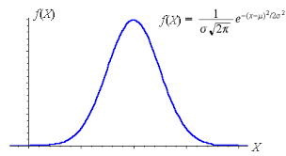
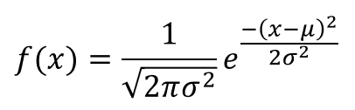

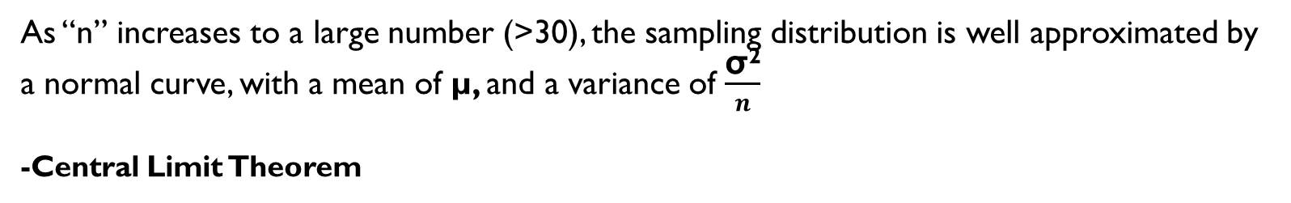
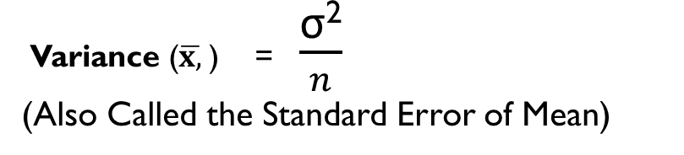
Revisiting Distributions Example of Sampling Distribution (Mean)
Variance ($\overline{x,}$) = $\frac{\text{σ}\text{2}}{n}$
(Also Called the Standard Error of Mean)
When “N” is Large the term $\frac{N−n}{N−1}$ will approach 1:
As “n” increases to a large number (>30), the sampling distribution is well approximated by a normal curve, with a mean of µ, and a variance of $\frac{\text{σ}\text{2}}{n}$
-Central Limit Theorem

Slide 10
Implication of distribution of sampling mean and CLT
Suppose we wish to estimate the Mean (μ) of a particular variable (say, Battery Life in Hrs) in a particular population (say, all that is produced in a batch)
You take a “large” enough sample from the batch and estimate the sample mean ( x̅ ) of life of batteries
Because you have used a large sample size, you can assume that the distribution of sampling mean will follow a normal curve for any given value of population mean(μ₀)
Using the normal curve equation, or the normal tables, you can actually find out the probability p of getting a sample mean of x̅ , when the population mean is μ₀
By evaluating the value of p, you make a judgment about the true population value μ

Slide 11
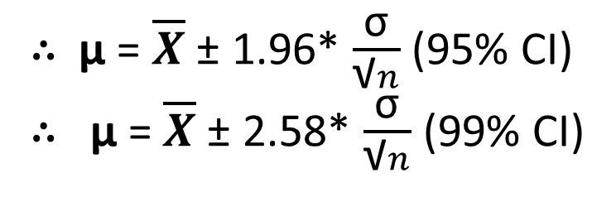

Confidence Intervals
If the sampling distribution of sample mean $\overline{x}$can be approximated by a normal distribution, then, there is a 95 % probability that the sample statistic $\overline{x}$ will fall within 2 standard errors of the population mean µ, and a 99% probability that it will fall within 3 standard errors of the population mean µ.
$\overline{X}$ = µ ± 1.96* $\frac{\text{σ}}{\text{√}n}$ (With a 95% probability)
$\overline{X}$ = µ ± 2.58* $\frac{\text{σ}}{\text{√}n}$ (With a 99% probability)
∴ µ = $\overline{X}$ ± 1.96* $\frac{\text{σ}}{\text{√}n}$ (95% CI)
∴ µ = $\overline{X}$ ± 2.58* $\frac{\text{σ}}{\text{√}n}$ (99% CI)
Symmetric, bell-shaped density function.
68% of area under the curve between μ ± σ.
95% of area under the curve between μ ± 2σ.
99.7% of area under the curve between μ ± 3σ.
.68
.95
μ−2σ
μ−σ
μ
μ+σ
μ+2σ

Slide 12
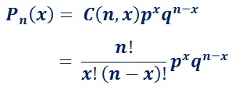
Sampling Distribution - Proportions
Toss of a coin: Pr(H) = p = 0.5 : Pr(T) = q = 0.5
Let’s say we toss the coin 5 times (n=5), Can we estimate the number of times heads will turn up?
The probabilities for a given number of heads(x) turning up can be computed by the binomial distribution function formula
Number of Heads | Freq | Prob
0 | 1 | 0.03125
1 | 5 | 0.15625
2 | 10 | 0.3125
3 | 10 | 0.3125
4 | 5 | 0.15625
5 | 1 | 0.03125
Total | 32
The binomial distribution function can also be well approximated by a normal curve, with a mean of µ = np, and a variance of σ² =npq

Slide 13
Sampling Distribution - Proportions
Tossing a fair coin 50 times
# of Heads, X | Pr(X), n=50, p=0.5
0 | 8.88178E-16
1 | 4.44089E-14
2 | 1.08802E-12
3 | 1.74083E-11
4 | 2.04547E-10
5 | 1.88184E-09
6 | 1.41138E-08
7 | 8.87152E-08
8 | 4.76844E-07
9 | 2.22527E-06
10 | 9.12362E-06
11 | 3.31768E-05
12 | 0.000107825
13 | 0.000315179
14 | 0.000832974
15 | 0.001999138
16 | 0.004373115
17 | 0.00874623
18 | 0.016034755
# of Heads, X | Pr(X), n=50, p=0.5
# of Heads, X | Pr(X), n=50, p=0.5
19 | 0.027005903
20 | 0.041859149
21 | 0.059798785
22 | 0.078825671
23 | 0.095961686
24 | 0.107956897
25 | 0.112275173
26 | 0.107956897
27 | 0.095961686
28 | 0.078825671
29 | 0.059798785
30 | 0.041859149
31 | 0.027005903
32 | 0.016034755
33 | 0.00874623
34 | 0.004373115
35 | 0.001999138
36 | 0.000832974
37 | 0.000315179
38 | 0.000107825
39 | 3.31768E-05
40 | 9.12362E-06
41 | 2.22527E-06
42 | 4.76844E-07
43 | 8.87152E-08
44 | 1.41138E-08
45 | 1.88184E-09
46 | 2.04547E-10
47 | 1.74083E-11
48 | 1.08802E-12
49 | 4.44089E-14
50 | 8.88178E-16
Pr(X) =19 to 31 = 0.935
A fair coin will give you 19 to 31 heads out of 50 tosses, 93.5 % of times you do this experiment
Using µ = np, and σ² =npq
Pr(X) =0 to 18 = 0.032
Pr(X) =32 to 50 = 0.032

Slide 14
Hypothesis Testing

Slide 15
Hypothesis Testing- Concept
What is a Hypothesis?
(A) A hypothesis is made on the basis of limited evidence as a starting point for further investigations.
(B) A hypothesis is a basis for reasoning without any assumption of its truth.
(C) Hypothesis is a proposed explanation for a phenomenon

Slide 16
Hypothesis Testing: Components
A statement of a hypothesis – Usually expressed as Null and alternate hypothesis (H₀, and H_{A}– Mutually Exclusive and Collectively Exhaustive)
A α value – referred to as Significance Level
A test Statistic (z, t, F for example)
A p value

Slide 17
Hypothesis Testing – α, β, and p
Your Product development claims to have created a superior version to the existing product
Modifications to the existing production facilities to produce the new product would cost USD 20 Million.
The potential increase in profits could be up to USD 40 Million if the new product is superior
You decided to test prototypes with customers
H₀ : The New product is as good as the old product, H₁ : The New Product is Superior
Data |  | Reality
 |  | New Product Not Superior | New Product is Superior
Suggestion of Evidence | New Product is not Superior | Correct Decision | Wrong Decision (Type II Error) β
 | New Product is Superior | Wrong Decision (Type I Error) α | Correct Decision

Slide 18
Hypothesis – An example
H₀ : The New product is as good as the old product,
H₁ : The New Product is Superior
Your Call |  | Reality
 |  | New Product Not Superior | New Product is Superior
Suggestion of Evidence | New Product is not Superior | Correct Decision | Wrong Decision (Type II Error) β
 | New Product is Superior | Wrong Decision (Type I Error) α | Correct Decision
The p value is a computed level of uncertainty about the evidence supporting the alternate hypothesis
α and β are the maximum level of uncertainties that one is willing to concede, in the conclusion that the new product is superior(i.e. when the null hypothesis is rejected), and when the new product is not superior (i.e the null hypothesis is accepeted)
The Values of α , and β are really a function of the consequences of the decisions

Slide 19
Hypothesis Testing – α, β, and p
Your Product development claims to have created a superior version to the existing product
Modifications to the existing production facilities to produce the new product would cost USD 20 Million.
The potential increase in profits could be up to USD 40 Million if the new product is superior
You decided to test prototypes with customers
H₀ : The New product is as good as the old product, H₁ : The New Product is Superior
Your Call |  | Reality
 |  | New Product Not Superior | New Product is Superior
Suggestion of Evidence | New Product is not Superior | Correct Decision | Wrong Decision (Type II Error) β
 | New Product is Superior | Wrong Decision (Type I Error) α | Correct Decision
You Can fix your α, understanding the consequences in terms of costs. Your own risk appetite is the only unknown.

Slide 20
Hypothesis Testing – α, β, and p
You can fix α , because you are hypothesizing a given value for H₀
β comes into play only H₀ is not true, but you still do not know the true value of the parameter to compute it. You only know what it is not.
α is normally fixed at one of the following values:
0.01 – If you seek very strong evidence
0.05 – If you seek fairly strong evidence
0.10 – If you are OK with a weak evidence
If p (Computed Uncertainty) is lower than α (the maximum permissible uncertainty), you reject H₀
p < α – Reject Null Hypothesis
p > α – Do Not Reject Null Hypothesis

Slide 21
The Test Statistic
This will vary depending on the test, but it will typically be the difference between the observed value in the sample and the hypothesized value divided by a standard error. Types of test statistic: z, t, χ2, and F test statistics.
The choice of test is a function of
What is tested?, and
Assumed Distribution of the population on what is tested, and
Number of samples involved

Slide 22
The Test Statistic
What is tested?: The most commonly tested items are “Test of Differences”
Is the proportion equal to a particular value, or is it different? H₀: π = k
Are two proportions from the study relating to two different sub-groups, equal or different? H₀: π₁ = π₂
Is the average from the study, equal to a particular value, or is it different? H₀: μ = k
Are two averages from the study, relating to two different sub-groups equal or different?
H₀: μ₁ = μ₂

Slide 23
The Test Statistic
Assumed Distribution of the population on what is tested
Parametric statistical test is one that makes assumptions about the parameters (defining properties) of the population distribution(s) from which one's data are drawn – General assumptions are the sample is drawn from a population, wherein the parameter is Normally distributed.

Slide 24
The Test statistic
Number of samples involved
One Sample
Example: To test whether the proportion of cars that have a damage is is < 25%, we will consider all the data as one Sample
Two Samples – Independent
Example: To test whether the proportion of cars with damage is related to transmission type we will consider the data for two transmission types, as two samples, independent of each other, i.e. there is no overlap of cars between the two groups

Slide 25
Hypothesis Testing – Procedure Steps
Formulate H₀ and H₁
Compare with Level of Significance, α
Select Appropriate Test
Reject or Do not Reject H₀
Choose Level of Significance, α
Draw Conclusion
Collect Data and Calculate Test Statistic
Determine Probability Associated with Test Statistic(p)

Slide 26
One sample test for mean

Slide 27
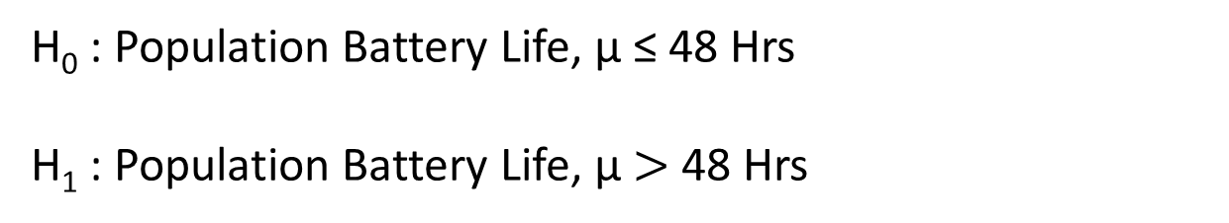
Hypothesis Testing – Procedure Steps - Example
We wanted to know, whether the claim made by the maker, that the battery life of the new model of phones is greater than 48 hrs.
We took a sample of 30 mobiles, and measured their battery life and we had an average battery life of 49.67 Hrs. Should we accept the claim made by the product?
Formulate H₀ and H₁
H₀ : Population Battery Life, μ ≤ 48 Hrs
H₁ : Population Battery Life, μ $>$ 48 Hrs
The testing will be made for the H₀ : μ = 48 Hrs
Because if you have strong enough evidence to reject the above H₀ , you will certainly have strong enough evidence to reject the H₀ : μ< 48 Hrs

Slide 28
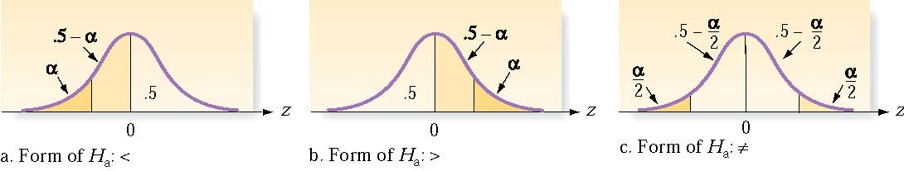
Hypothesis Testing – Procedure Steps - Example
Select Appropriate Test
What is tested? – A Mean being equal to a given value H₀ : μ = 48 Hrs & H_{A} : μ > 48 Hrs
2. Assumed Distribution of the population on what is tested. – Normal – Hence a t– test
3. Number of samples involved- One
A one – Sample, One – tailed#, t- test of mean
#
Our H_{A} : μ > 48 Hrs

Slide 29
Hypothesis Testing – Procedure Steps - Example
Choose Level of Significance, α
Considerations: The claim should be made, only if μ > 48, and if we wrongly conclude that μ > 48, when in reality μ ≤ 48, we will lose the confidence of the consumer. So we require fairly strong evidence, and therefore let us choose an α = 0.05

Slide 30

Hypothesis Testing – Procedure Steps - Example
Collect Data and Calculate Test Statistic
The formula for the t- statistic is given by
Only when a sample is large enough, we can use the normal distribution, and z- values for computation
If the samples are small, you can use the t-distribution, and t-statistic, instead of the z-statistics
= $\frac{\text{7.81}}{\text{√}30}$
= 1.425
t = (49.67 – 48)/1.425 = 1.172

Slide 31
Hypothesis Testing – Procedure Steps - Example
Determine Probability Associated with Test Statistic (p)
Shaded Area
= 0.8747
You can compute p from the cumulative t-distribution table, t_{d.f.=29} = 1.172 corresponds to a p value of 0.1253
Unshaded Area
= 0.1253
Compare (p) with Level of Significance, α
μ = 48
t = 1.172
P= 0.1253, is higher than the α value of 0.05
i.e. Computed Uncertainty Level is higher than the chosen maximum uncertainty level permissible
i.e. The evidence is not strong enough to reject the Null Hypothesis ( i.e. H₀ : μ ≤ 48 Hrs)

Slide 32
Hypothesis Testing – Procedure Steps - Example
What it means:
Though our sample average of battery life was 49.67 Hrs, given the sample size, and variation in the data, we cannot conclusively reject the hypothesis, that the population mean battery life μ ≤ 48 Hrs
Reject or Do not Reject H₀
The null hypothesis
H₀ : Population Battery Life, μ ≤ 48 Hrs
is not rejected
Draw Conclusion
Do not make the claim

Slide 33
Hypothesis Testing
Because of the example we had chosen to focus on had a variable (Battery Life), whose mean value was of interest to us, we had conducted the Test of means
The same manufacturer may also be interested in controlling the variation in battery life made from different plants at the same level. In which case he would be testing the Hypotheses H : σ_{A} = σ_{B} = σ_{C} (Test of equality of variances)
Or, he might be checking whether the QC pass proportion is above the target set by him to his plant B (H: π_{B} > target proportion)
Or, Whether the mean battery life of batteries from two different plants A, and C are the same (H: μ_{A} = μ_{C} )
Business requirements will determine the kind of hypothesis test that is required

Slide 34
Hypothesis Test - Options
Sample | Data | Purpose | Hypothesis | Test/s
One | Categorical (Nominal/Ordinal) | Test proportion | H₀ : π = K | Binomial Test z -Test
One | Ordered Qualitative Quantitative | Test Median | Population Median = K | One sample Wilcoxon signed rank test
One | Qualitative | Test Distribution (Goodness of Fit) | Sample is drawn from population with a specific distribution | Chi Square (χ²) K – S one sample test
One | Quantitative (Interval/Ratio) | Test Mean | H₀ : μ = K | One sample t-test

Slide 35
Hypothesis Test - Options
Sample | Data | Purpose | Hypothesis | Test/s
Two Independent | Qualitative | Test proportion | H₀ : π₁ = π₂ | z -Test
Two - Independent | Ordered Qualitative Quantitative | Test Median | Two samples come from Populations with the same Median | Mann – Whitney U test
Two - Independent | Continuous (Interval/Ratio) | Test Mean | H₀ : μ₁ = μ₂ | t- Test (with F-Test)
Sample | Data | Purpose | Hypothesis | Test/s
Two - Paired | Qualitative | Test proportion | H₀ : π₁ = π₂ | McNemar Test
Two - Paired | Ordered Qualitative Quantitative | Test Median | Two samples come from Populations with the same Median | Wilcoxon Signed Rank
Two - Paired | Continuous (Interval/Ratio) | Test Mean | H₀ : μ₁ = μ₂ | t- Test (with F-Test)

Slide 36
References
https://stackoverflow.com/questions/2324438/how-to-calculate-the-statistics-t-test-with-numpy

Slide 37
The End

